Slide 1
Predicting Runs
Nothing But Elastic Nets
Derek Owens-Oas, Federico Ferrari, Fan Bu, Megan Robertson

Slide 2
Defining an “exciting” run
Challenging part of the prompt
Impossible to incorporate every possible run
Determine a reasonable definition of run
Our definition
In a rolling time window (eg. 2min)
Point difference > a certain threshold (eg. 6pts)
Differentiate between teams (favorable runs; hostile runs)
2
2

Slide 3
Defining an “exciting” run
3
3

Slide 4
Feature Generation
Capturing the variability in defining a run
Measuring the pace – number of shots, number of rebounds, possession length
Accounting for player skill– how many all stars
Team – not all teams are equal
Game clock
4
4

Slide 5
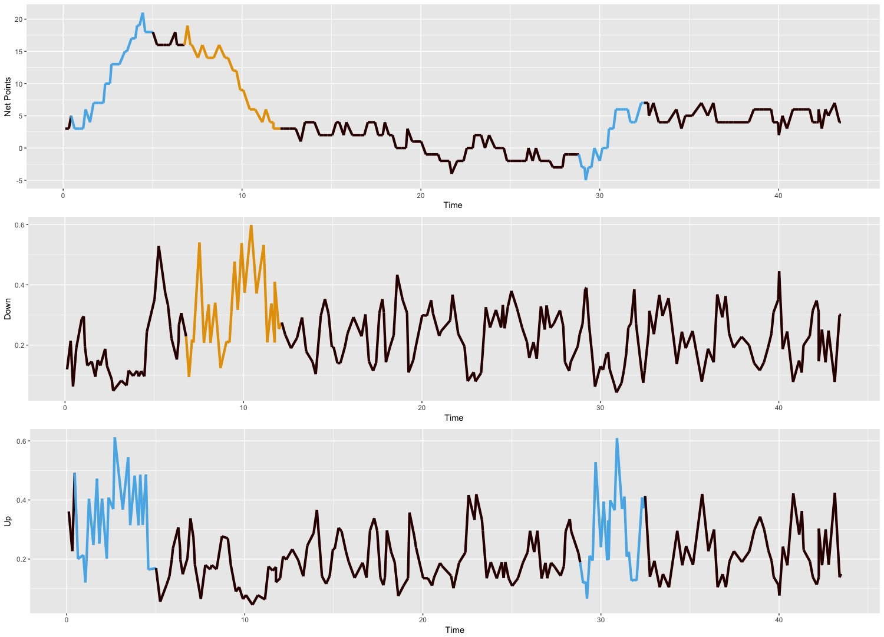
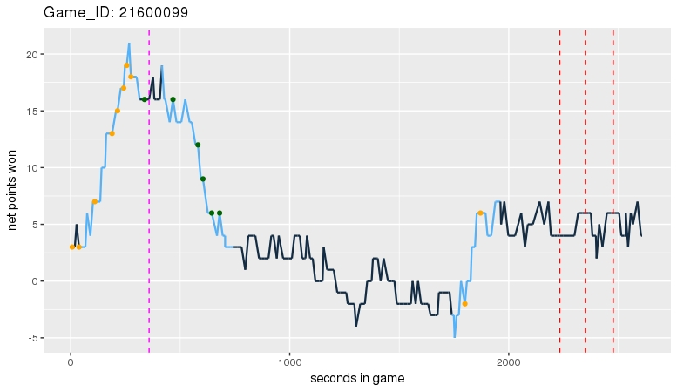
Modeling Run Prediction
Predicting possessions as a classification problem
5
5

Slide 6
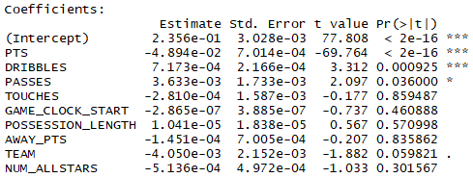
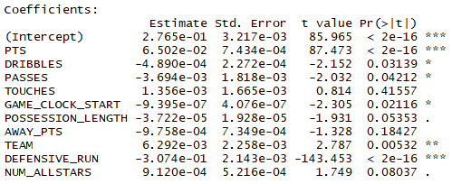
Interpreting coefficients
How did the models perform?
Run Against Model
Run For Model
6
6

